Slide 1
Seasonality of COVID-19 in Cobb County, GA
Sarah Tillman

Slide 2
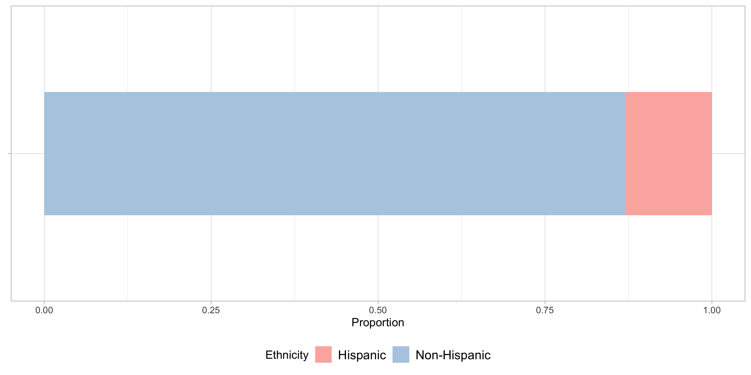
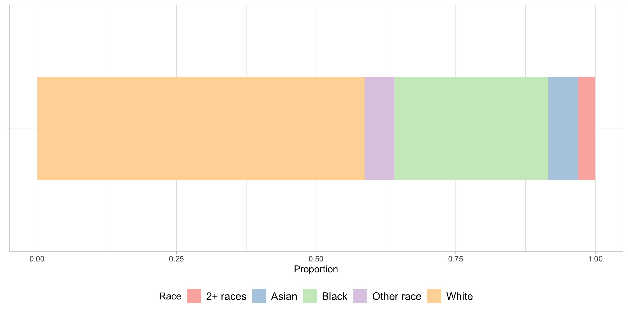
Demographics: Cobb County, GA
Data: ACS 5-Year Data Estimates (2019)

Slide 3
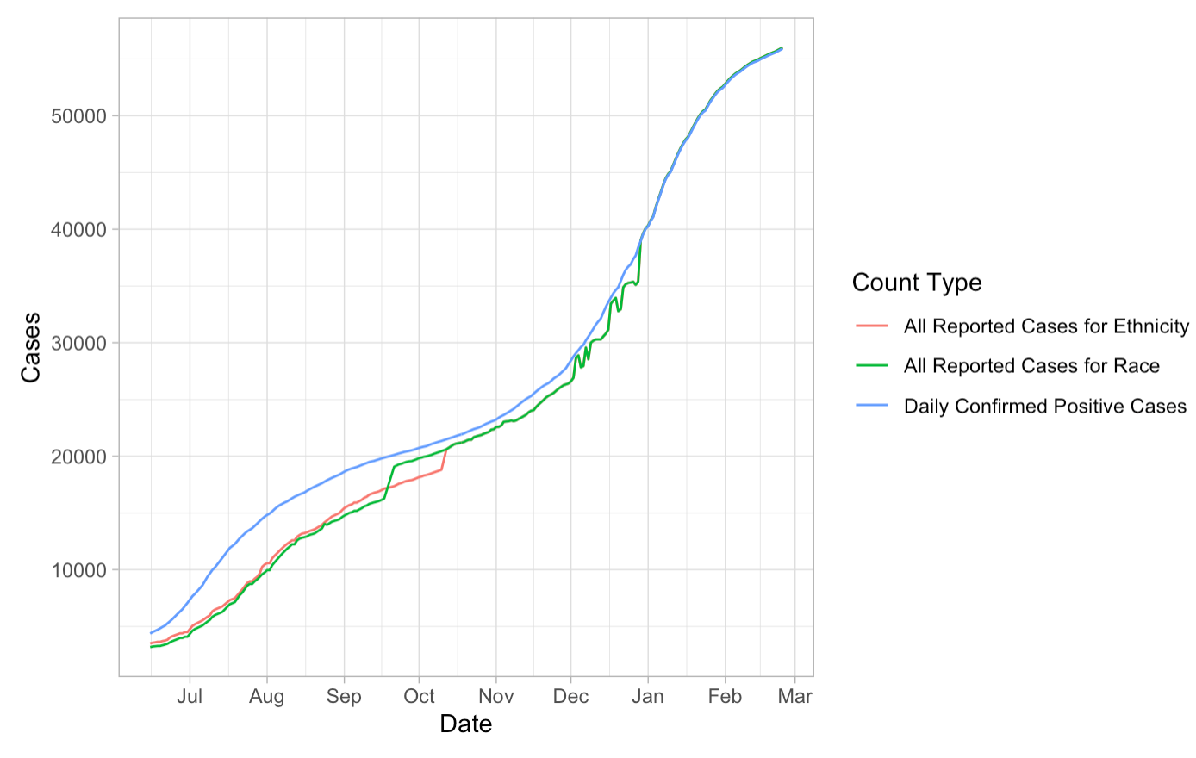
COVID-19 Cumulative Case Counts
Data: Broadstreet COVID-19 Data Project (2021)

Slide 4
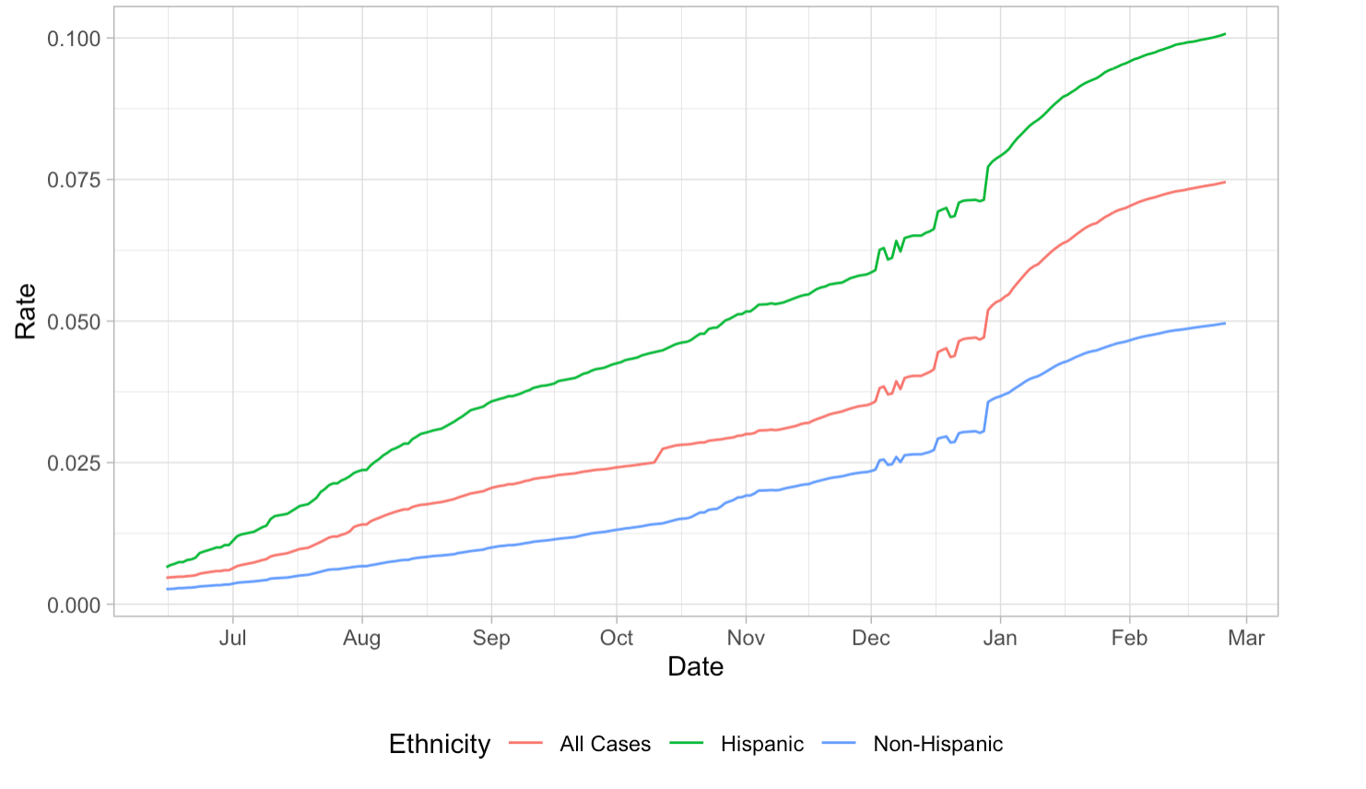
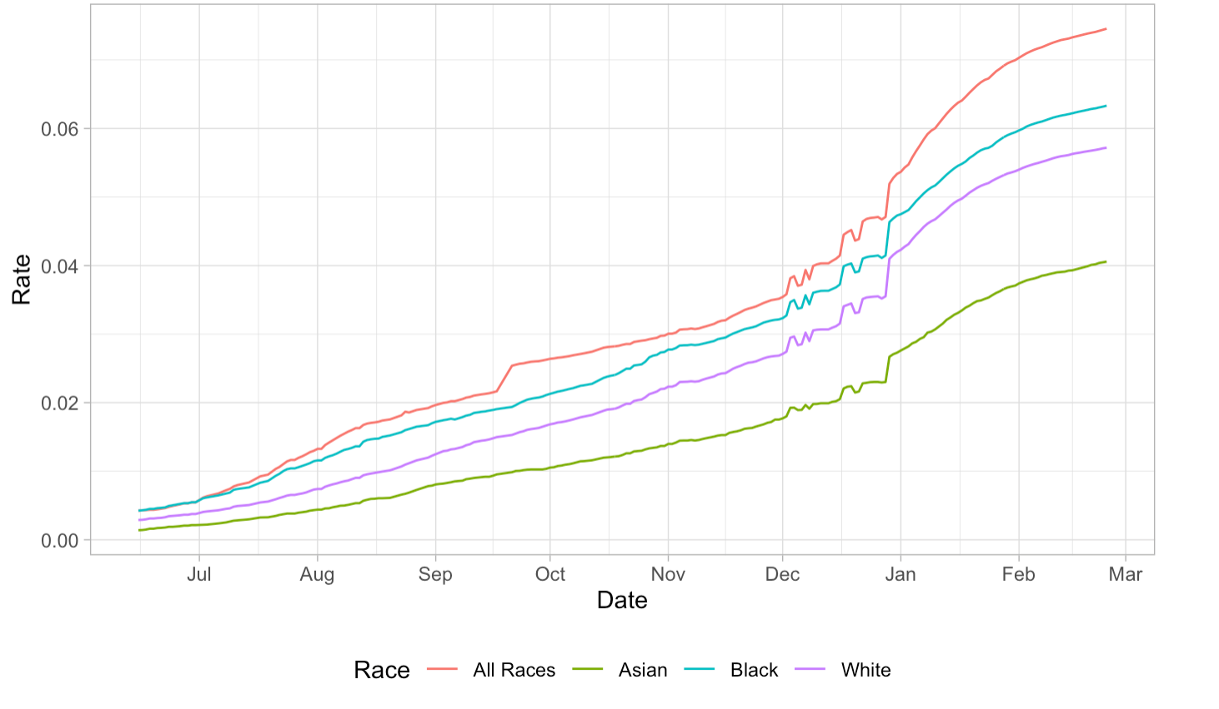
COVID-19 Cumulative Case Rates
Data: Broadstreet COVID-19 Data Project (2021)

Slide 5
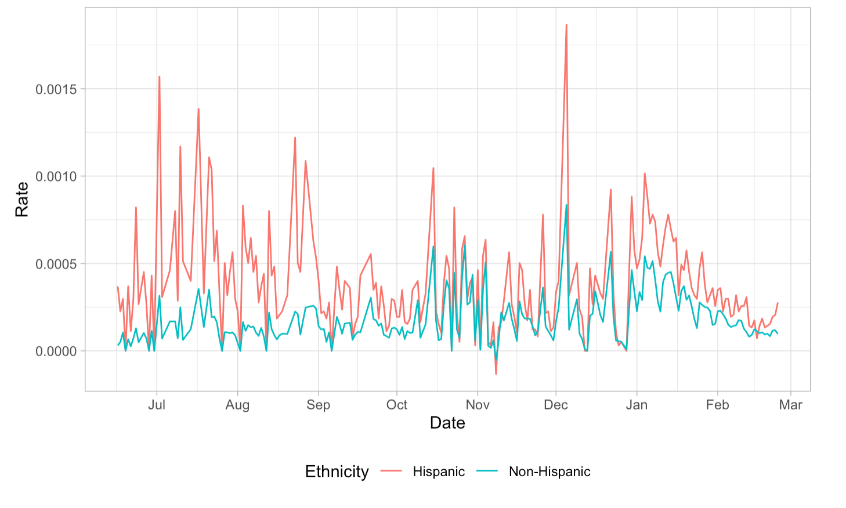
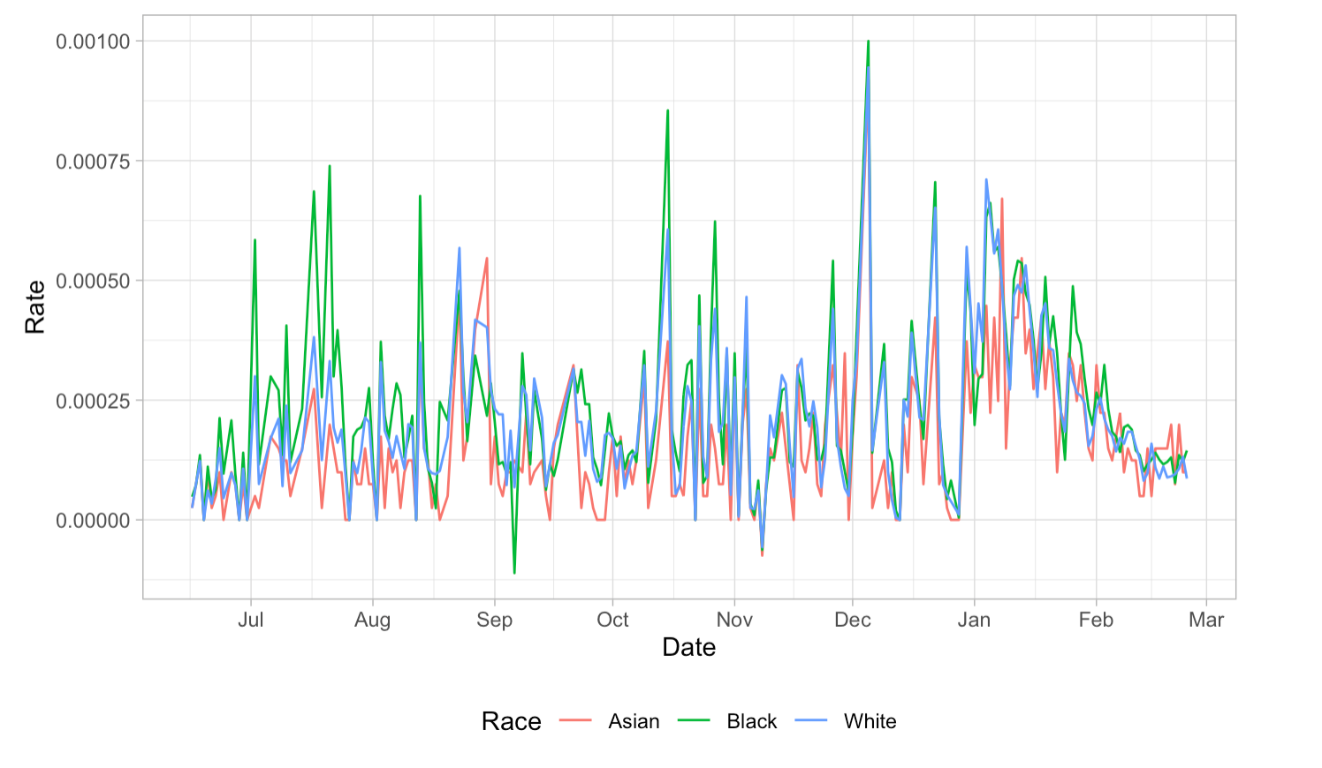
COVID-19 Daily Case Rates
Data: Broadstreet COVID-19 Data Project (2021)

Slide 6
Average Number of New Cases per Day
 | Summer | Fall | Winter
All Races | 150.64 | 109.16 | 266.72
Asian | 3.32 | 4.30 | 8.42
Black or African American | 35.10 | 34.66 | 55.03
White | 54.57 | 71.96 | 110.92
 | Summer | Fall | Winter
All Cases | 156.29 | 115.34 | 266.72
Hispanic | 37.60 | 24.69 | 35.95
Non-Hispanic | 62.76 | 99.09 | 141.52

Slide 7
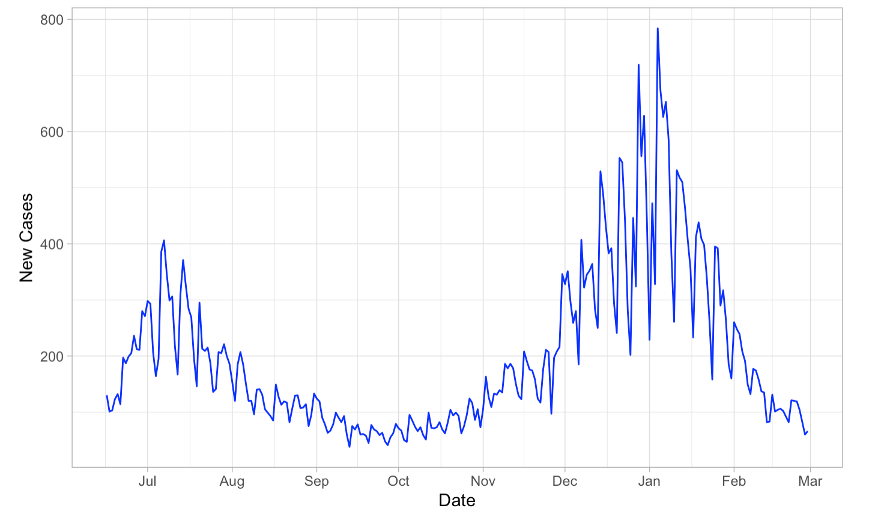
COVID-19 Daily Confirmed Cases
Data: Broadstreet COVID-19 Data Project (2021)

